Slide 1
Transforming Homes, Elevating Values

Slide 2
Group 6 Team
Caroline Njoroge Amadi Growman James Nyamu Robert Gesembe Lynns Waswa David Kirianja

Slide 3
Business Overview
Introduction and Objectives
Welcome to Reno Strategix, where the realms of real estate and home renovations converge.
This project addresses a pressing issue faced by CasaCrafters Realty Solutions: the need to provide data-driven guidance on home improvements for increased property value.
Our focus is not only on boosting value but also on enhancing overall appeal, guided by multiple linear regression modelling using King County house sales data.

Slide 4
Background of the study
Introduction and Objectives
Homeowners often grapple with the challenge of deciding on renovations that significantly enhance property values. CasaCrafters aims to fill this void by offering tailored advice grounded in a thorough analysis of the King County real estate market.
Business Problem
Objective 1
To develop a multiple linear regression model to identify and quantify the impact of features (e.g., square footage, bedrooms) on house sale prices in King County.
Objective 2
To Construct a robust regression model predicting house sale prices based on selected features for personalized property valuation.
Objective 3
To utilize the regression model to generate personalized recommendations, suggesting renovations predicted to have the highest positive impact on property values.

Slide 5

Rationale for achieving the objectives
Rationale
Identify Key Features influencing property values
Building a Predictive Model
Provide Recommendations

Slide 6

Data source, preparation and use
Data Understanding
Data Source:
Kings county housing data
Data Preparation:
Import data, explore, understand dataset, identify wrangling techniques for analysis.
Exploratory Data Analysis
Examine structure, scrutinize properties, comprehend description, sample initial five rows.

Slide 7









The process flow
Data Manipulation
Checking shape, inspecting properties, understanding description, and sampling rows.
Conclusions drawn; detected 1153 outliers in price using interquartile
Historical data was used
range.
Data
Pre-Processin g
Data cleaning and Manipulation
Categorical Variables
Data
Exploratory data analysis
Outlier Detection
Importing, exploring, and determining data wrangling for analysis and modeling.
Assessed nulls, replaced missing values, adjusted data types, created column.
Identified categorical variables: waterfront, view, condition, and grade columns, representing discrete categories or labels in the dataset.

Slide 8
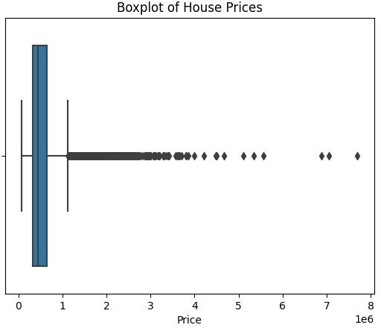
Price outliers
Outliers
Identified 1153 outliers.
Lower bound: -162,500.0,
Upper bound: 1,129,500.0.

Slide 9
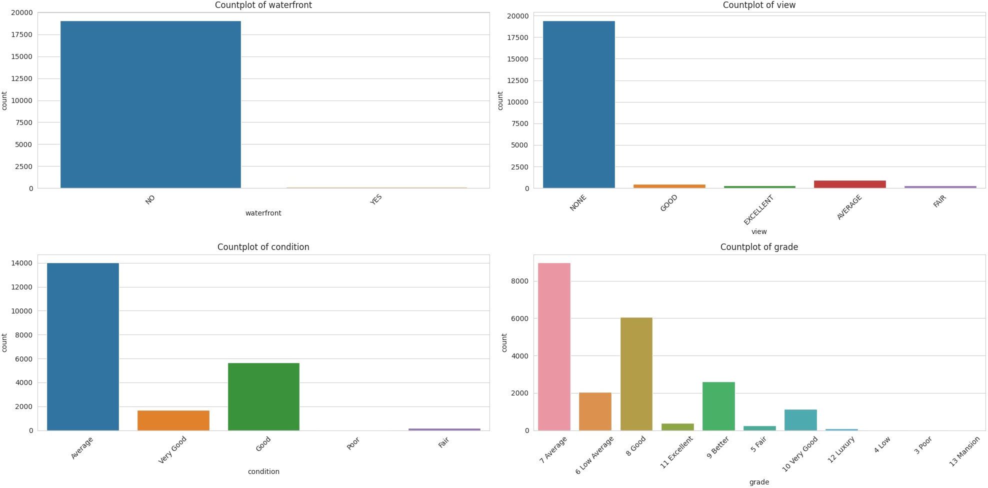
Categorical variables
Grouped variables
There were 1153 outliers, with the lower bound set at -162,500.0 and the upper
bound at 1,129,500.0

Slide 10
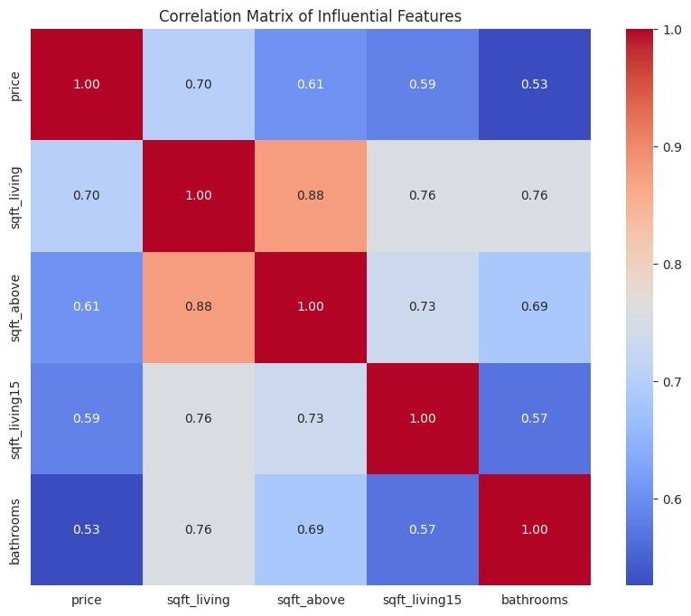
Identifying the most influential features through analysis and correlation
Feature Selection
Using Pearson correlation in pandas, we obtained the correlation matrix for all the numerical columns in the dataset.
To the right is the representation of the correlation in the correlation matrix;

Slide 11
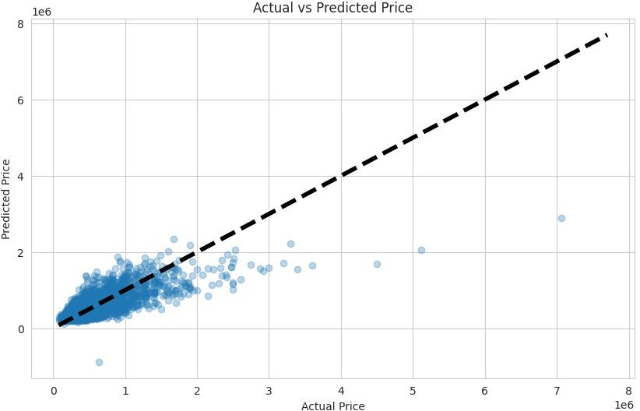
Train a multiple linear regression model using the selected
Modeling Building
features
Split data into training and testing sets, trained model, and assessed performance.
The Mean Squared Error (MSE) at
58.3 billion signifies the average squared difference between predicted and actual prices.
R-squared at 0.55 implies the proportion of house price variance explained by selected features, higher values indicating a better fit; refer to the scatter plot for visual representation.

Slide 12
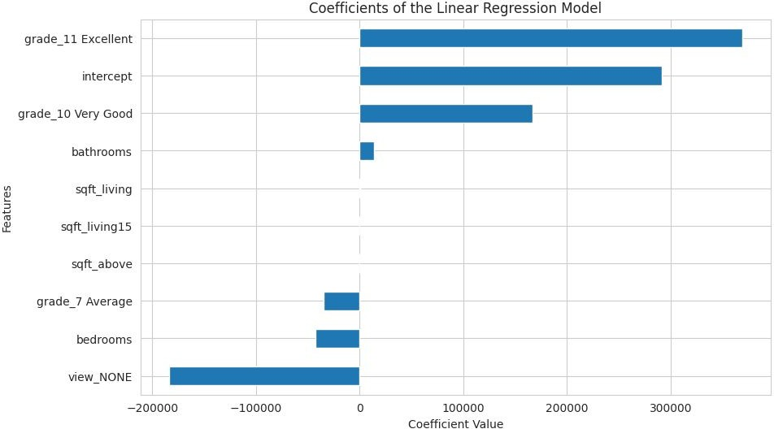
Assessing the performance of the model and interpreting the coefficients
Modeling Evaluation
Coefficients in Linear Regression
Positive coefficients: Positive correlation with target variable.
Negative coefficients: Negative correlation.
Intercept: Estimated target variable value when all features are zero.

Slide 13
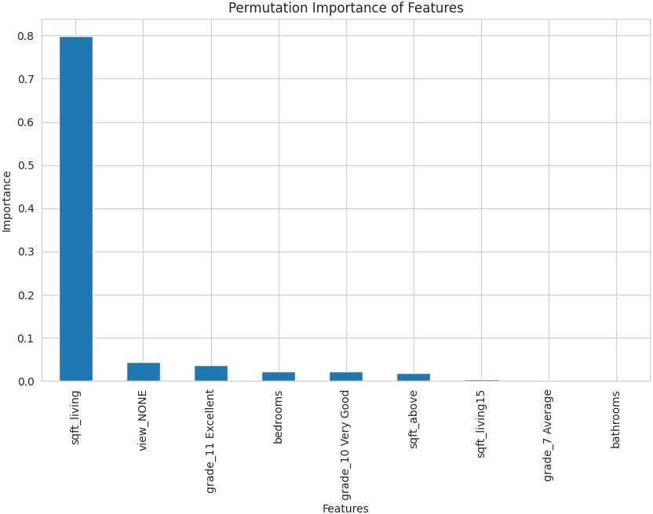
Developing a system to recommend specific renovations based on their predicted impact on house prices
Recommendation System
Sqft_living holds the highest importance score, signifying that alterations in living area square footage have the most significant potential impact on house prices.
Bathrooms exhibit an extremely low importance score, indicating a minimal impact on house prices

Slide 14
Conclusions
Conclusions
1.
House size in square ft holds the highest importance score, meaning that the the more square feet a house has the higher its price is.
2.
A Very Good grade increases the house price compared to the baseline grade
3.
Bathrooms have a significantly low importance score, suggesting a minimal influence on house prices.

Slide 15
Recommendations
Recommendations
Based on the model insights, here is clear and actionable advice for homeowners considering renovations to increase their house's value:
Recommendation
Explanation
Maximize Living Space
Expanding the living space is a key strategy for maximizing the house's value. Consider options like room additions, finishing basements, or creating open floor plans
Strategic Bathroom
Additions
Strategically adding bathrooms can be a valuable investment. Evaluate the existing layout and identify spaces where an additional bathroom could enhance convenience and appeal.
Grade Upgrades
Upgrading the house grade, especially to 'Excellent,' can significantly increase the property's market value. Explore ways to enhance the quality of materials and finishes in your home.

Slide 16
Recommendations
Recommendations
Recommendation
Explanation
Budget Assessment
Assess the return on investment for each proposed renovation in line with your budget; prioritize projects aligned with financial capacity and long-term goals.
Understand Local Market Trends
Factors such as market conditions, neighborhood trends, and buyer preferences can influence the impact of renovations on property value.
Emphasize Quality
Prioritize quality over quantity in renovations; strategic improvements enhancing functionality and aesthetics yield favorable returns.
Comprehensive renovations, accounting for features like square footage and bathrooms, alongside overall appeal, significantly boost a property's market value.
Adopt a Holistic Approach

Slide 17
Questions?
Q&A

